Slide 1
Corpus Linguistics
2023-11-10
Levels of Linguistic Representation

Slide 2
From last class
Sample & Population
Skewing & Balance
Parameters of a corpus
Representativeness, Spontaneity, Routinization, Saturation
Variants, lexical vs. external conditioning
Lexical semantics
Synonyms and meaning clusters
Review of concepts from phonology / phonetics

Slide 3
This class
Phonetics
Morphology
Syntax
Discourse

Slide 4
Praat
website: https://www.fon.hum.uva.nl/praat/download_win.html

Slide 5
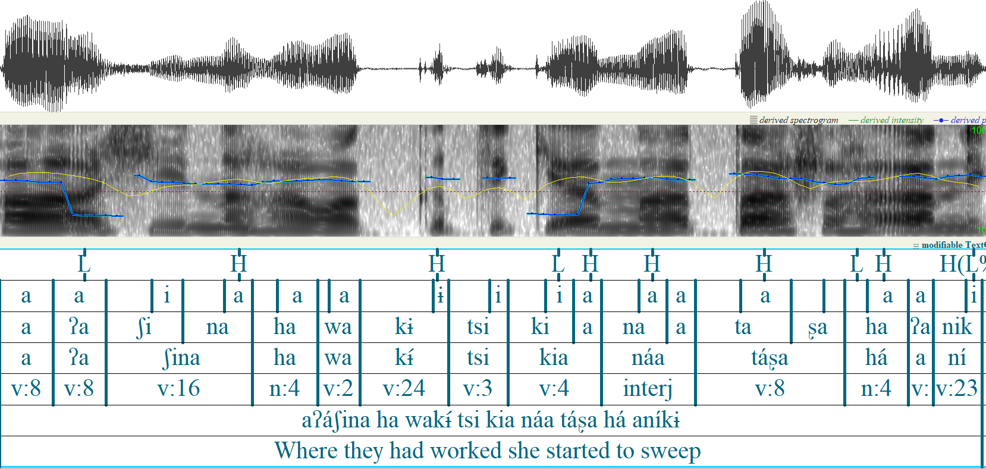
This is a Praat annotation of a sentence in Chácobo, a southern Pano language of the northern Bolivian Amazon.

Slide 6
Waveform
Spectrogram
Tiers
This is a Praat annotation of a sentence in Chácobo, a southern Pano language of the northern Bolivian Amazon.

Slide 7
Phonetic measurements
Phones have different phonetic measurements associated with them.
A consonant has
Duration (milliseconds)
Voice onset and offset time (milliseconds)
Voicing (milliseconds or amplitude
Vowel
Duration (milliseconds)
Pitch (F0)
Intensity (amplitude)

Slide 8
Phonetic measurements
F1 and F2
Vowels have an F1 and an F2
These are the main measurements of vowel quality.
F1: Vowel height (low F1 means high)
F2: Vowel frontness (high F2 means front)

Slide 9
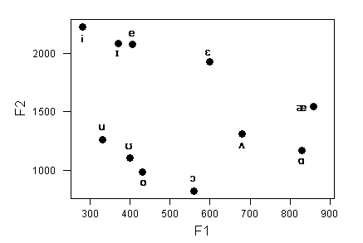

Slide 10
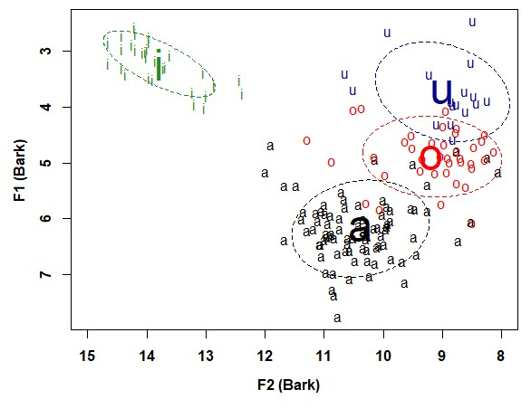
Phonetic measurements
Actual vowel tokens are much more variable
https://fass.ubd.edu.bn/research/dusun/vowels3.html

Slide 11
Phonetic measurements
How does one develop a phonetic annotation? (e.g. know the boundaries between different sounds)
There are acoustic ‘landmarks’ that can be used to segment speech into phones.
But
Developing a phonetic corpus by hand is very time consuming – which is why people use forced alignment systems.

Slide 12
Morphology
Morphemes
Allomorphy
Rules or schemas
Compositionality
Productivity
realized, expanded, potential
Segmentability
Morphology and phonetic reduction
Borrowing

Slide 13
Morphology
Morphology is concerned with word internal structure (generally)
A central concept is the morpheme
Words are made up of morphemes – morphemes are the smallest meaningful parts of words.
complete-ness has two morphemes

Slide 14
Morphology
Some other core concepts:
Bound: Some morphemes are ‘free’ (they can occur on their own) and others are bound (they depend on the appearance of something else to occur)
Roots: The base of th Word, e.g. (complete in completeness)
Affixes: The bound parts that are modifying the base (-ness in completeness

Slide 15
Morphophonology / Allomorphy
Morphemes have different realizations depending on context
Plural –s is realized as –s or –z or -əz depending on the word
dogs > [dagz]; cat > [kæts]

Slide 16
Rules or Schemas
There are a few different ways of thinking about the combination of morphological elements
Rules: Discrete statements with an input and an output
Plural rule: X → X+əz
Schemas: “Generalization over words having similar patterns and phonological connections“

Slide 17
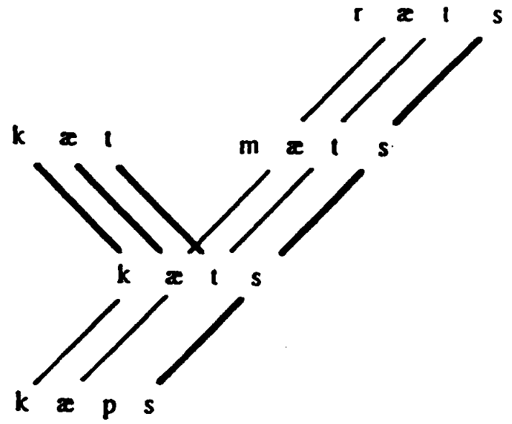
Schemas

Slide 18
Schemas
The basic idea is that you build new words on analogy with other words based on phonological connections
But a schema can be abstract:
X-əz
X-ən plural
CʊC~CiC

Slide 19
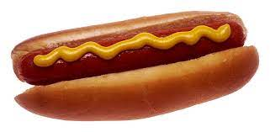
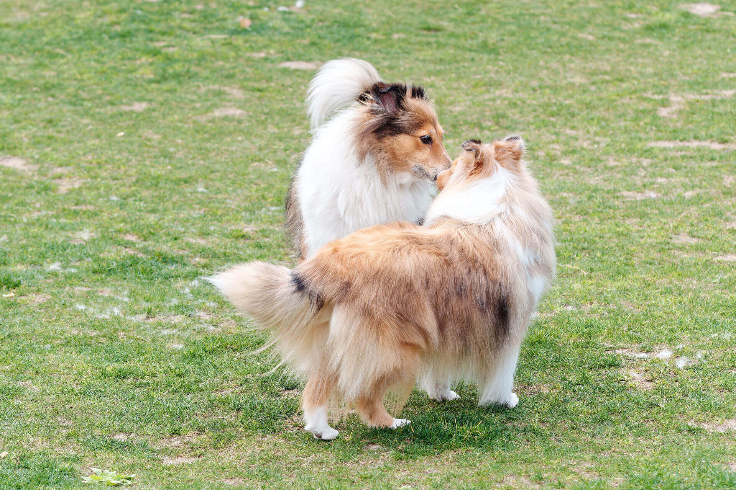
Compositionality
Words vary in terms of how compositional they
How easy it is to discern the meaning of the whole from the parts
hot dog not very compositional

Slide 20
Morphological productivity
Morphemes vary in terms of their productivity.
Some morphemes like –ness are highly productive
Others like –th in warmth only occur with a small number of forms.

Slide 21
Morphological productivity
Realized productivity: high memberships (lots of words have this morpheme)
Expanded productivity: growing memberships (new words use this morpheme)
Potential productivity: we think it could be used with lots of words

Slide 22

Different notions of productivity based on analogies with economics
Realized productivity: how much has been produced in the past (production)
Expanding productivity: based on changes in what is produced over time (profit)
Potential productivity: based on how crowded the market it is ...
potential productivity can be determined by saturation of competing morphological schemas

Slide 23
Realized productivity
Should we measure realized productivity in terms of token or type frequency?

Slide 24
Realized productivity
It is measured by type-frequency of the schema
Productive categories have a large number of low-frequency forms
exoticize~exoticized
Unproductive categories tend to contain many high-frequency forms
keep~kept, sleep~slept

Slide 25
Expanding productivity
Expanded productivity is based an inherently diachronic concept
It can be measured by how many hapax legomena appear in corpora
Hapax legomena: Forms that only appear once
(e.g. flother, as a synonym for snowflake)

Slide 26
Potential productivity
Morphological schemas encode categories
Morphological schemas can be more or less saturated with respect to a category
This is measured by hapax legomena divided by the total number of tokens of the category that a morphological schema encodes

Slide 27
Segmentability
Morphological forms can be more or less segmentable by speakers/hearers
The idea is that when you hear a word you, you can either hear it holistically or into pieces.
The less frequent the word form is in relation to the pieces that make it up, the more segmentable it is

Slide 28
Morphology and phonetic reduction
As words become more frequent they become pronunced faster (they undergo phonetic reduction)
Such processes of reduction can decrease segmentability even further.
“Some words are reduced to such an extent that a faithful orthographic transcription would be very different from the orthographic norm. An example from Dutch is the word mogelijk ‚possible‘ which can be pronounced not only as [moxələk] but also as [moxək, [molək], or even as [mok]“ (Keune et al. 2004)

Slide 29
Borrowing

Slide 30
Syntax
Concepts in syntax:
constituents
phrases, clauses
order
gramatical relations

Slide 31
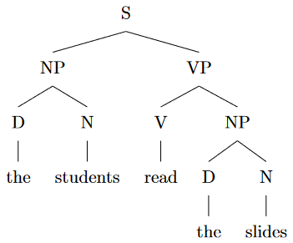
Words, phrases and constituents
Sentences are not just strings of words but have constituent structure

Slide 32
Grammatical relations
Grammatical relations refer to subject, object, indirect object etc...
Subject
Object

Slide 33
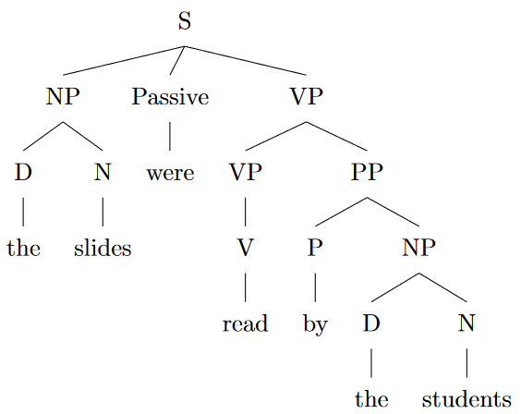
Syntax can frame the same events or situations in different ways
The framing gives different conceptualizations of a situation

Slide 34
Bresnan et al.
Bresnan et al. studied the dative alternation.
(1) Josh gave toys to the children
NP PP
Josh gave the children the toys
NP NP
Bresnan, Joan, Anna Cueni, Tatiana Nikitina, and Harald Baayen. 2007. Predicting the dative alternation. In G. Boume, I. Kraemer, and J. Zwarts, eds., Cognitive Foundations of Interpretation, pages 69–94. Amsterdam: Royal Netherlands Academy of Science

Slide 35
Bresnan et al.
Traditional analysis:
There are two ways of conceptualizing a giving event.
Meaning-to-Structure Mapping Hypothesis
causing a change of state (possession) → V NP NP
example: Susan gave the children toys
causing a change of place (movement to goal)
example: Susan gave toys to the children → V NP [to NP]

Slide 36
Bresnan et al.
There are two types of evidence for this:
Idioms that can’t involve movement to a goal
Constructions where a movement interpretation must be there.

Slide 37
Bresnan et al.
a. That movie gave me the creeps
b. *That movie gave the creeps to me.
a. The lighting here gives me a headache.
b. *The lighting here gives a headache to me

Slide 38
Bresnan et al.
Verbs of force:
a. I carried/pulled/schlepped/lifted/lowered/hauled the box to John
b. *I carried/pulled/pushed/schlepped/lifted/lowered/hauled John the box

Slide 39
Bresnan et al.
But if we search corpora we find counterexamples
The broadcast, which disrupted households, interrupted religious services, created traffic jams and clogged communications systems, was made by Orson Welles, who as the radio character, "The Shadow," used to give "the creeps" to countless child listeners. This time at least a score of adults required medical treatment for shock and hysteria.
https://sunshine10700.livejournal.com/2917.html?
This story is designed to give the creeps to people who hate spiders, but is not true. It is a long-standing urban legend. There is no documented case of this having happened and according to insect and cactus experts, including David Eppele of Arizona Cactus & Succulent Research, tarantulas breed in the ground, not in plants or trees.
https://www.truthorfiction.com/cactus/?utm_content=cmp-true
The out-of-towner had been giving Malka a hard time. He won a big pot and when Malka pushed him the chips, he didn't tip the dealer. Moss didn't like that.
https://lcb.org/news/editorials/the-last-interview

Slide 40
Bresnan et al.
Are these sporadic errors?
It turns out grammaticality judgements are more complex and can be overridden by various factors.
e.g. the principle of end weight (Behaghel 1909; Wasow 2002) can override semantic considerations (heavier NPs occur at the end)

Slide 41
Bresnan et al.
Important point:
“Linguistic intuitions of ungrammaticality are a poor guide to the space of grammatical possibility” (p. 8)

Slide 42
Bresnan et al.
But using corpus data are complicated:
“Yet what really dries the English dative alternation remains unclear because of four problems inherent to the use of corpus data. First, pervasive correlations in the data seem to support reductive theories which explan the phenomena in terms of a single variable. Second, pooled data from multiple speakers may invalidategrammatical inference if our subject matter is the internalized grammar of the individual. Third, properties such as animacy and discourse accessibility, which characterize the referents of noun phrases might derive from verb sen semantics. And fourth, cross-corpus differences appear to undermine the relevant of corpus studies to grammatical theory...” (Bresnan et al. 11)

Slide 43
Bresnan et al.
We’ll discuss these issures when we discuss statistical analysis

Slide 44
Discourse
Turn-taking
Conversational analysis
Critical discourse analysis

Slide 45
Turn-taking
Conversation analysis is concerned with patterns that can be observed in sequences of interactions between speakers/listeners.
Pausing and adding fillers like umm, agreeing or disagreeing actually follow patterns that help speakers/hearers process speech in conversation
An important issue in conversation analysis is turn-taking

Slide 46
Turn-taking
Turn-taking in conversation is striking for two reasons
Floor transfers: How do you know when the other person is done talking?
There are very few overlaps and very few gaps:
Speakers don’t interrupt each other (very much)
The pause between turns is very short, processing and planning for next turn has to occur before the speaker is done
The transition is so fast that speakers use words like um to avoid being interrupted while they are planning the next speech act

Slide 47
Turn-taking
How do you predict floor transfers from onne speaker to another?
A number of factors:
Turn-taking, Frequency, Concreteness, Surprisal, Syntactic Complexity, Sequence Organization
Sequence Organization: Adjacency pairs (“what do you think?”), Response tokens (“yeah” “mm”), Laughter
Roberts et al. 2015 ‘The effects of processing and sequence organization on the timing of turn taking: a corpus study’ Frontiers in Psychology 6

Slide 48
Critical discourse analysis
Critical discourse analysis is another field that relies crucially on corpora
Critical discourse analysis is about how language maintains, constructs and disseminates “discourses”
Discourse – ideologically specific way of viewing the world
Ideologies are world views that that constitute social cognition

Slide 49
Critical discourse analysis
Types of discourses:
racist
anti-semitic
immigration
asylum
neoliberal
What types of words, expressions and turns of phrases evoke or support ideologies

Slide 50
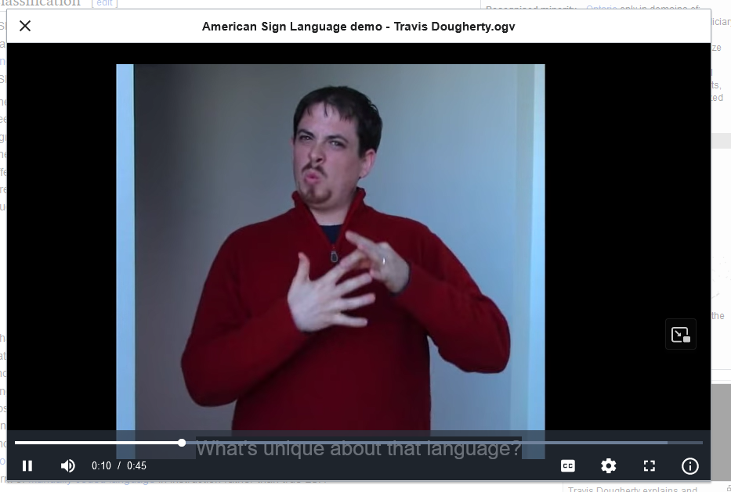
Register
mode: spoken versus signed
participants: who are the people involved and what relationships do they have to one another
communicative purpose: why are you talking to one another
https://en.wikipedia.org/wiki/American_Sign_Language

Slide 51
Genre
A genre is defined by linguistic features that are conventionally used with it.
Prose writing, poetry, fairy tales
Note that genres are culturally specific (they usually have names)
Genre marker: A specific property that marks off a genre

Slide 52
Genre
In Chácobo there is a specific ‘male joking genre’ of speech, which is characterized heavily by the liberal use of adjectivalizers.
Typically between men drinking chicha
Some sentences which appear in this context are judged unacceptable or ungrammatical outside of it.
jënë pohi=xëni mia
chicha shit-ter you
“You are a habitual chicha shitter.”

Slide 53
Style
Like genre but about individuals:
Some people just use certain constructions more than others
These can be markers of social identity, but they can also be very specific.

Slide 54
Linked data
Rawa vs. primary data
Time alignment
Metadata

